Slide 1
Data Set Cards
CSC 2621 Introduction to Data Science

Slide 2
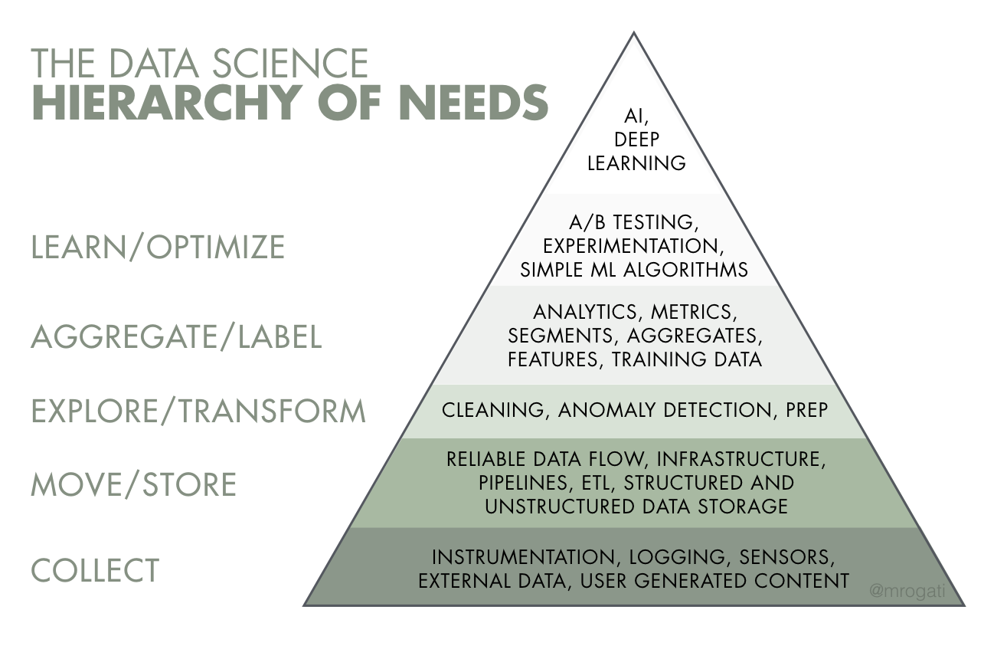
https://hackernoon.com/the-ai-hierarchy-of-needs-18f111fcc007

Slide 3
Exploratory Data Analysis
EDA is the process of visually and statistically exploring your dataset to understand its structure, patterns, and any underlying relationships. It's the detective work of data science.
Benefits:
Build familiarity with the data
Identify relationships between features and response
Understand what data might be missing, incomplete, or “wrong”

Slide 4
EDA
Goals:
Uncover Patterns
Identify Outliers
Understand Distributions
Feature Selection and Opportunities for Feature Engineering
Assumption Checking
Summarize 1000’s of Observations Visually

Slide 5
Data Cards
Adapted from hugging face
Each dataset may be documented by a readme.md
Concise documents designed to describe and track data sets
Provides a comprehensive snapshot of the datasets
Origin
Collection methods
Features
Statistical Insights

Slide 6
Importance of Data Cards
Why do we need them?
In the pursuit of data science, clarity about your data is as vital as the data itself. Data Set Cards serve as a compass, guiding you through the intricacies of your dataset.

Slide 7
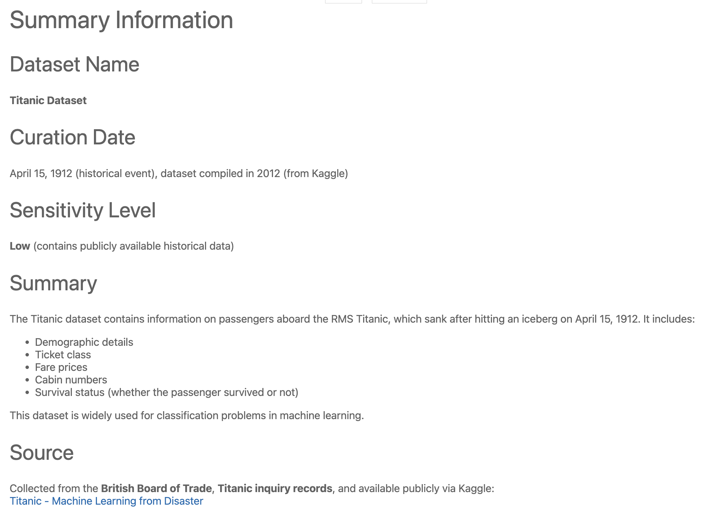
Summary Information
Describes the dataset and its purpose.
Key fields:
Name
Curation Date
Sensitivity Level
Summary
Source

Slide 8
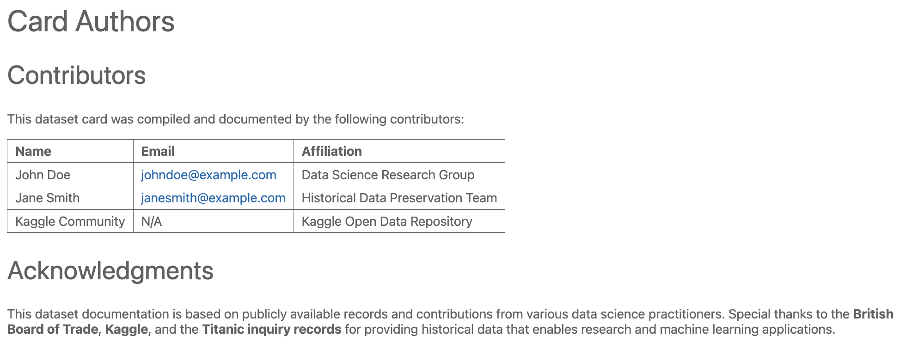
Card Authors
Documents the contributors who created the dataset card.
Why it matters:
Tracks authorship and accountability
Enables collaboration

Slide 9
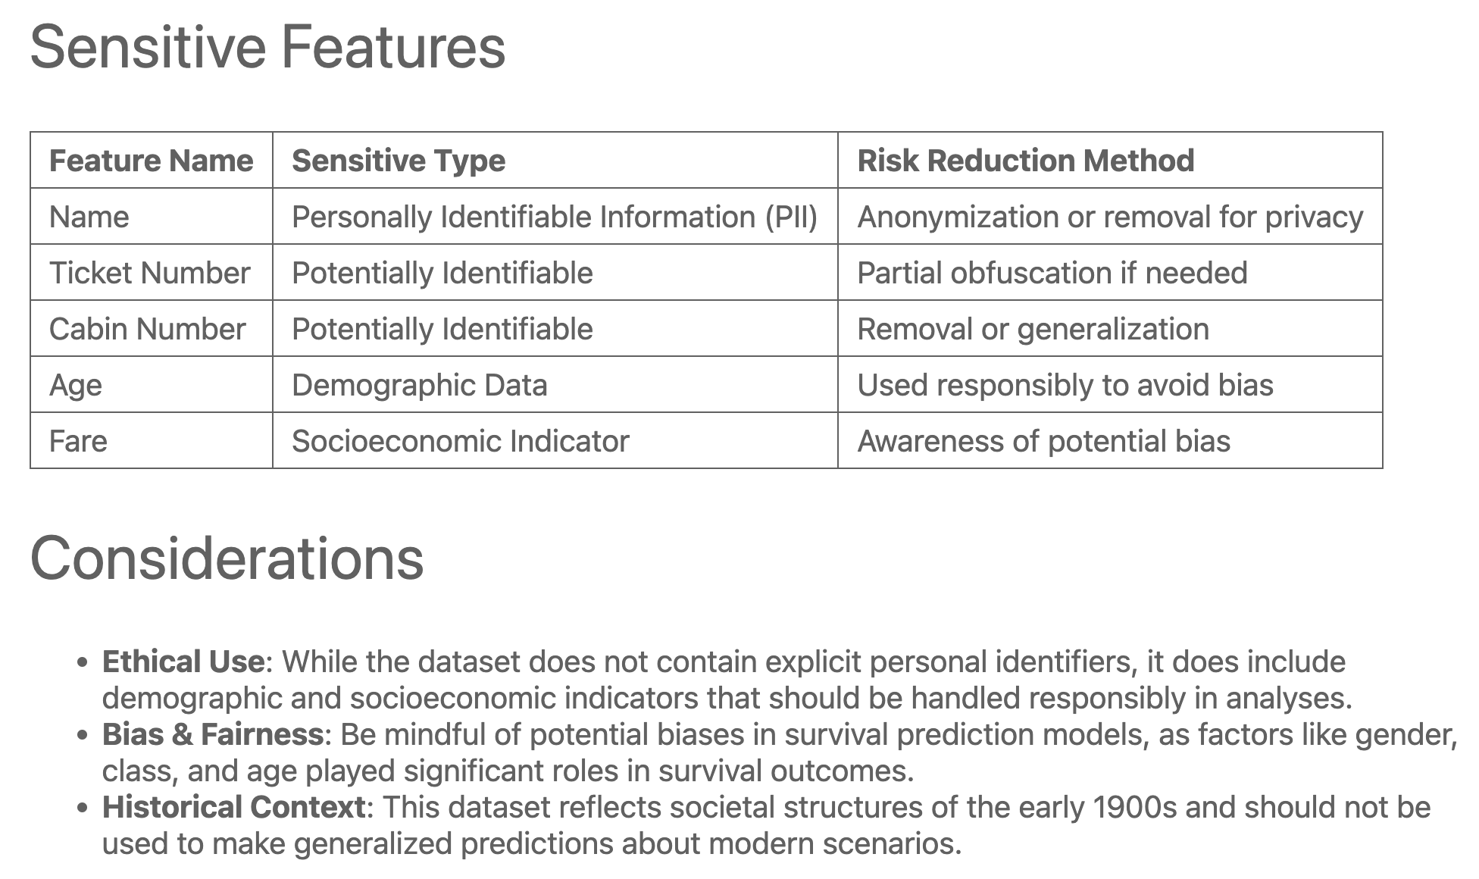
Known Sensitive Features
Highlights potentially sensitive attributes in the dataset.
Risk Reduction:
Anonymization
Aggregation

Slide 10
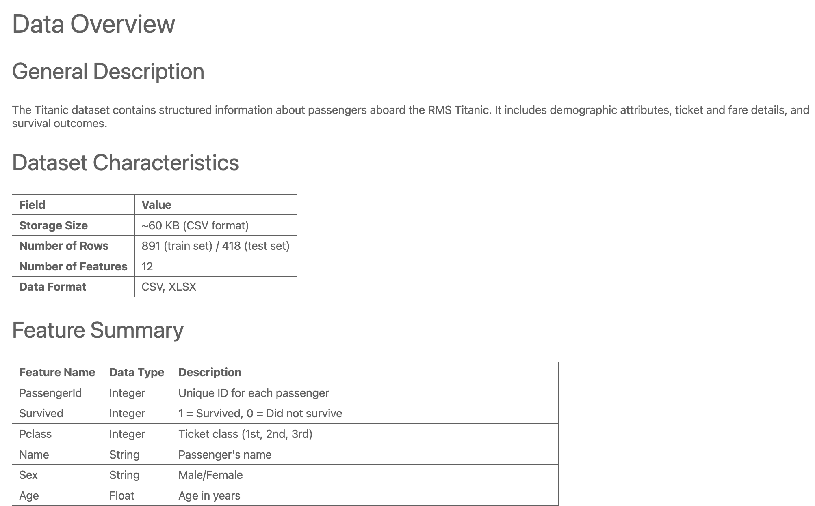
Data Overview
Provides a high-level summary of the dataset characteristics.
Key fields:
Storage Size
Number of Rows
Number of Features
Data Format

Slide 11
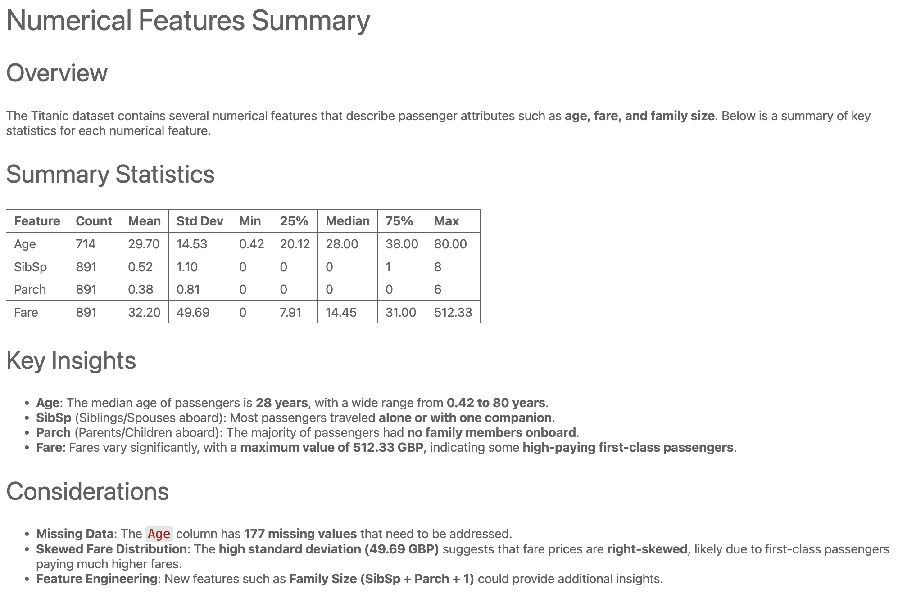
Numerical Features Summary
Summarizes key statistics for numerical variables.
Metrics:
Count
Mean
Standard Deviation
Min/Max values
Quartiles (25%, 50%, 75%)

Slide 12
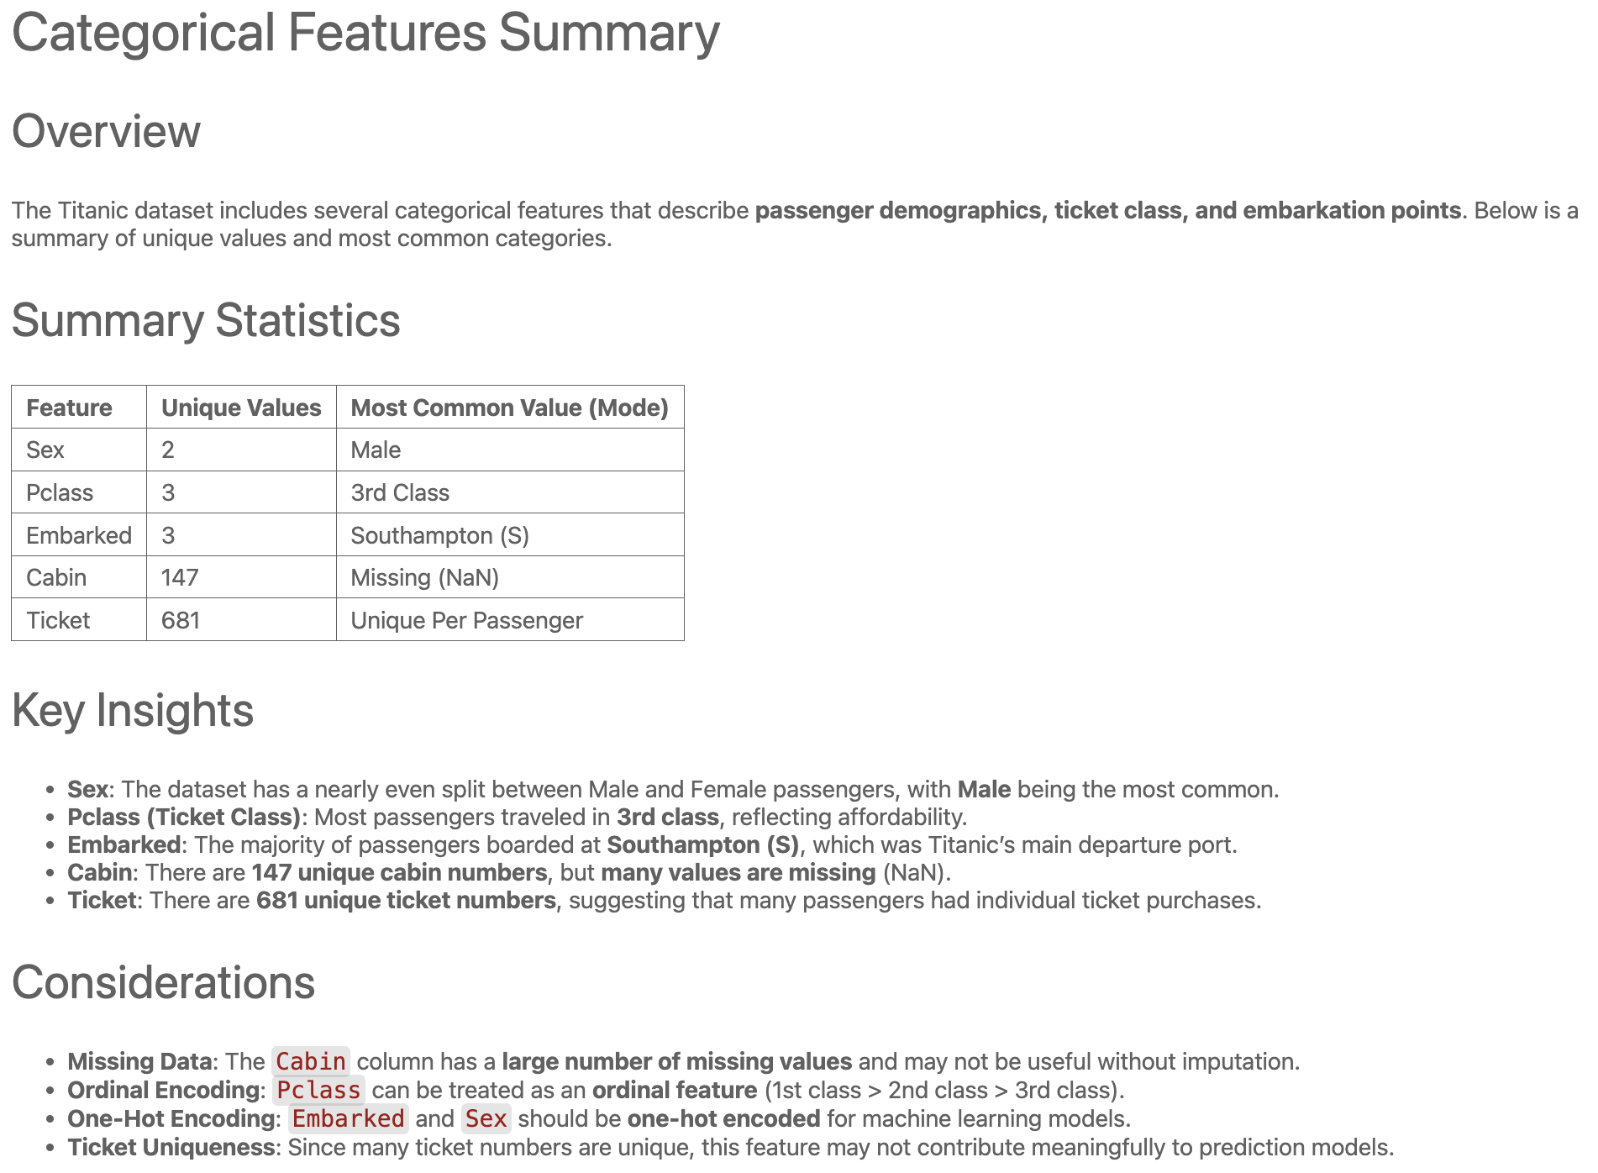
Categorical Features Summary
Summarizes key statistics for categorical variables.
Metrics:
Unique Values
Most Common Value

Slide 13
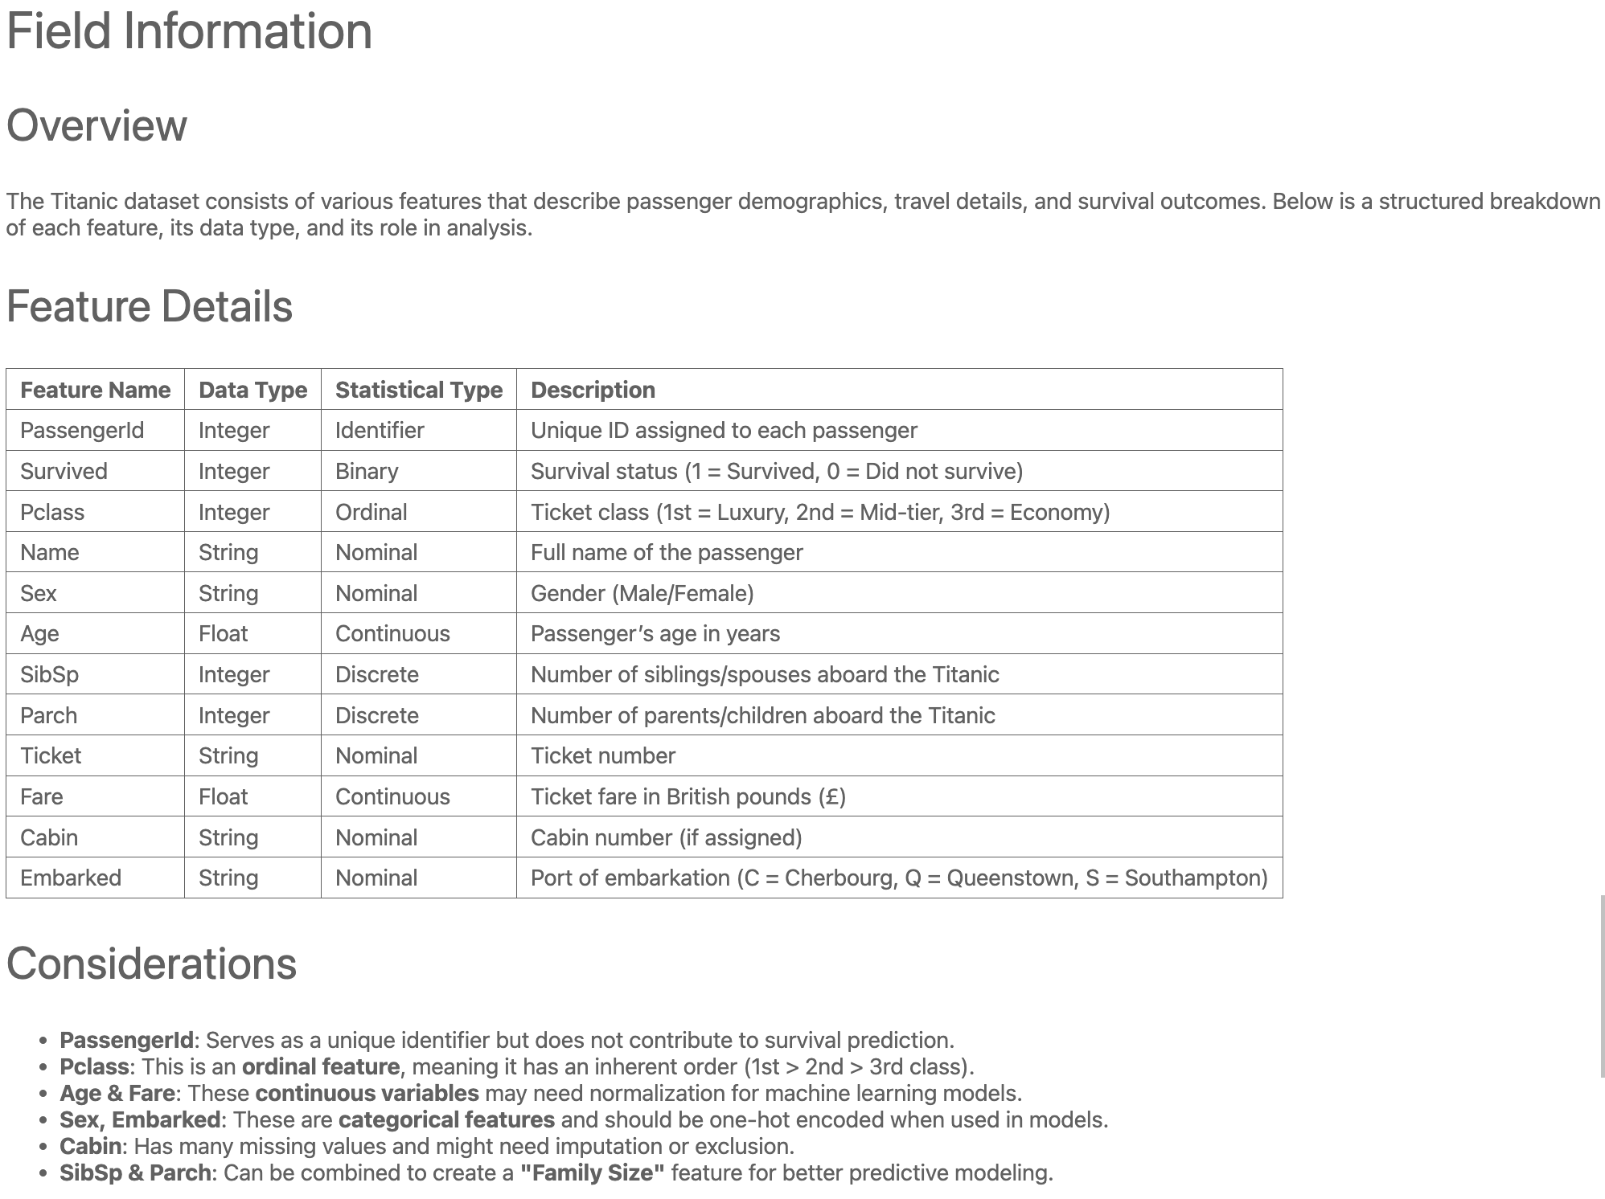
Field Information
Documents each feature in the dataset.
Includes:
- Feature Name
- Data Type
- Statistical Type
- Description

Slide 14
Example Entry
Provides representative dataset examples.
Why?
Helps users understand typical and edge-case data points
Aids in debugging and model development

Slide 15
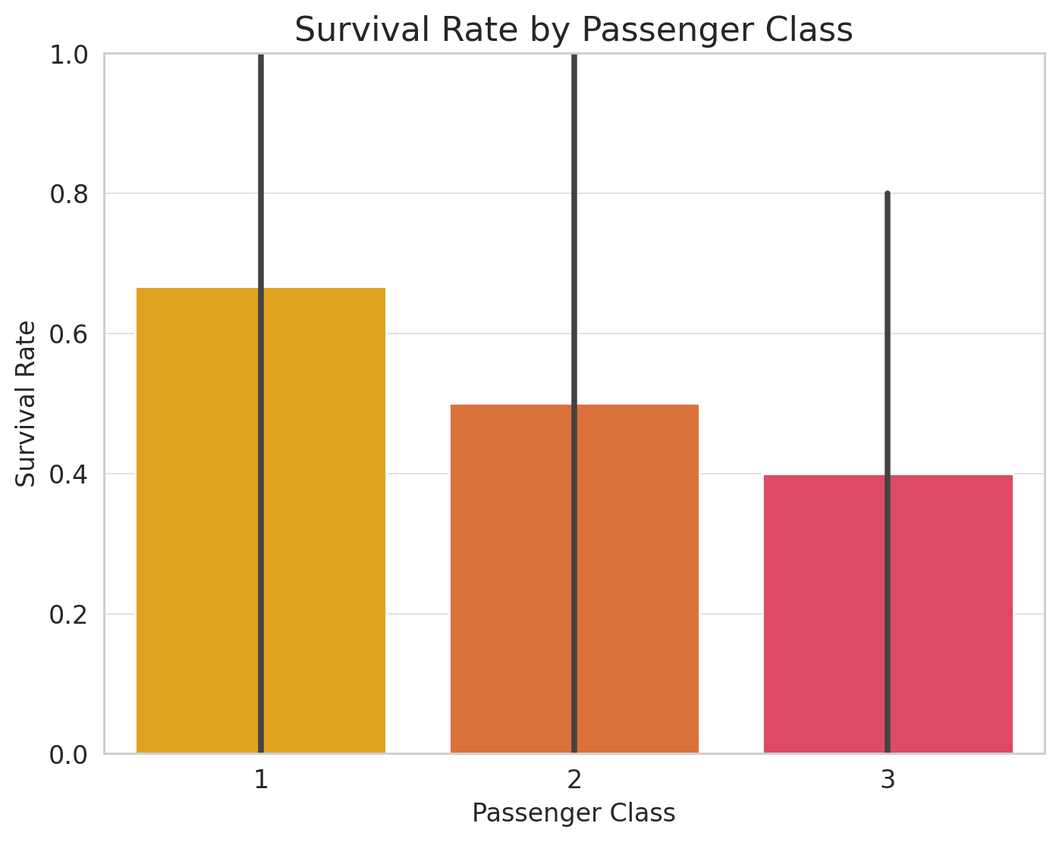
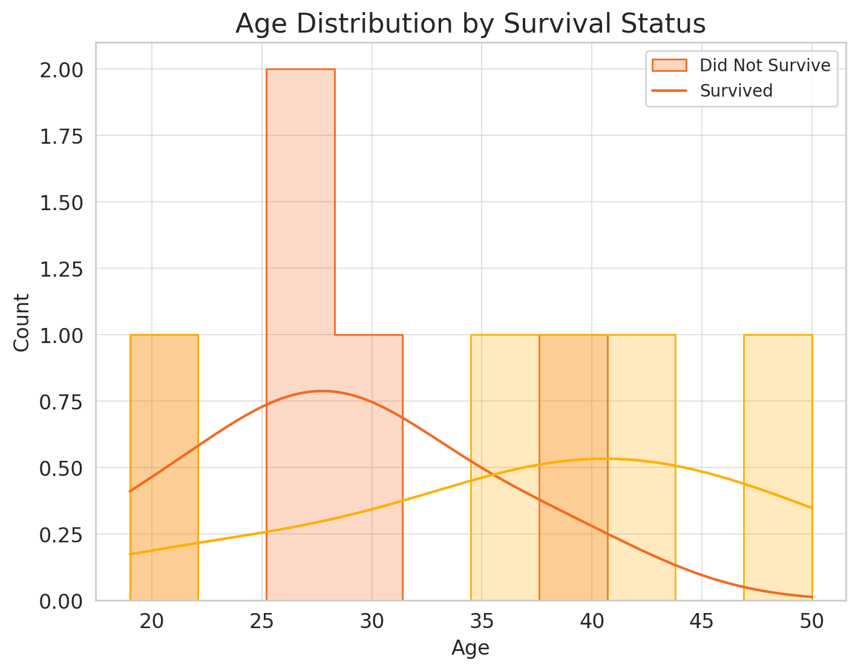
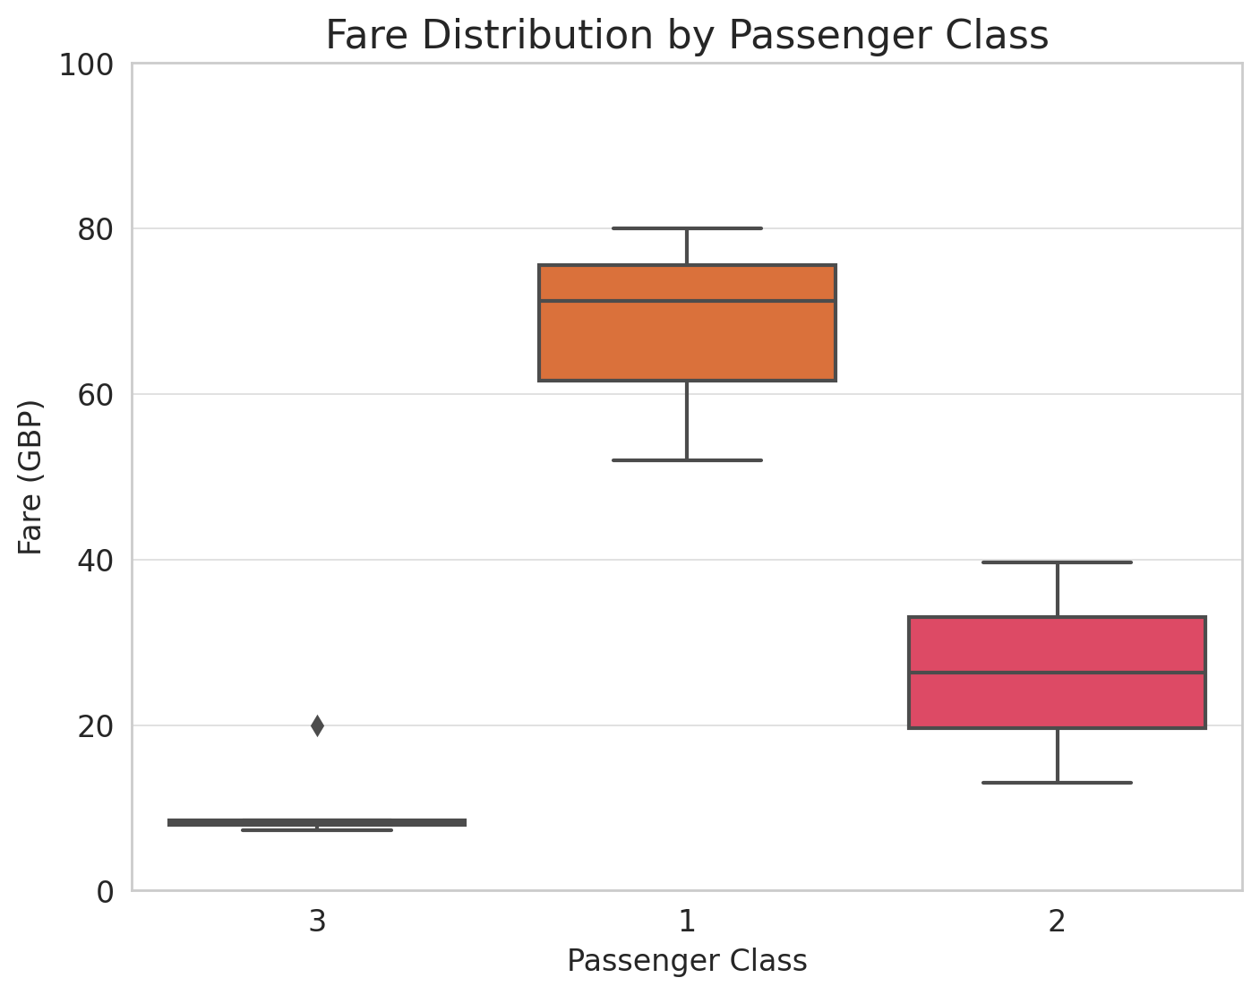
Exploratory Charts
Visualizes dataset characteristics.
Common visualizations:
Scatter plot matrices for numerical features
Bar graphs for categorical features
Principal Component Analysis (PCA) plots

Slide 16
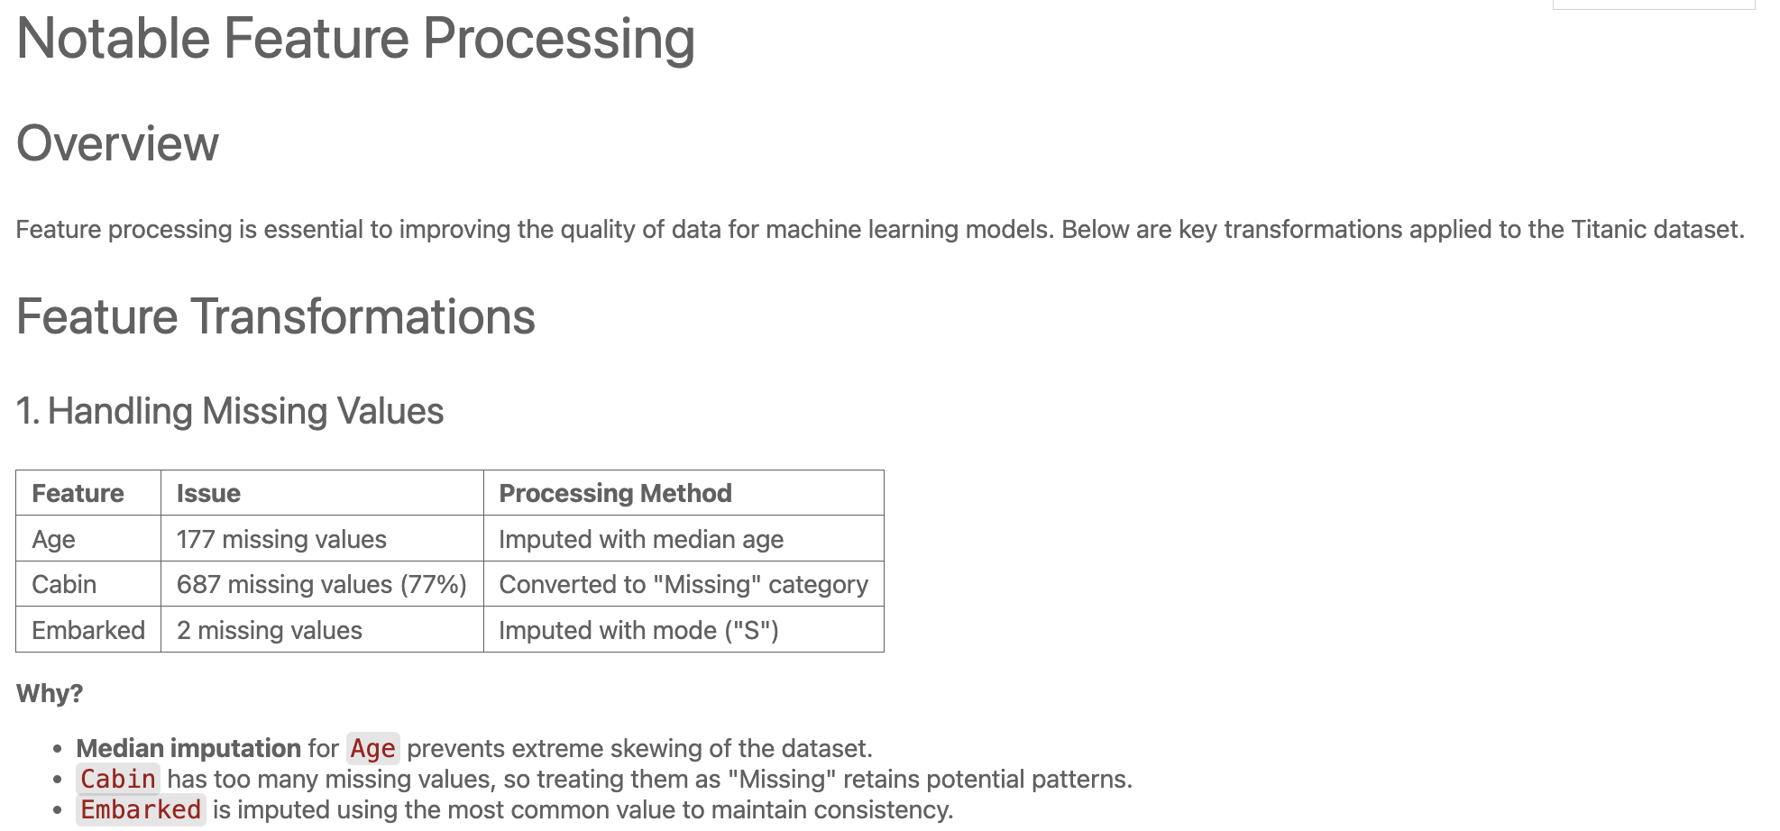
Notable Feature Processing
Records any transformations applied to features.
Examples:
Feature scaling
Feature engineering
Why it matters:
Ensures reproducibility
Facilitates model application on future data

Slide 17
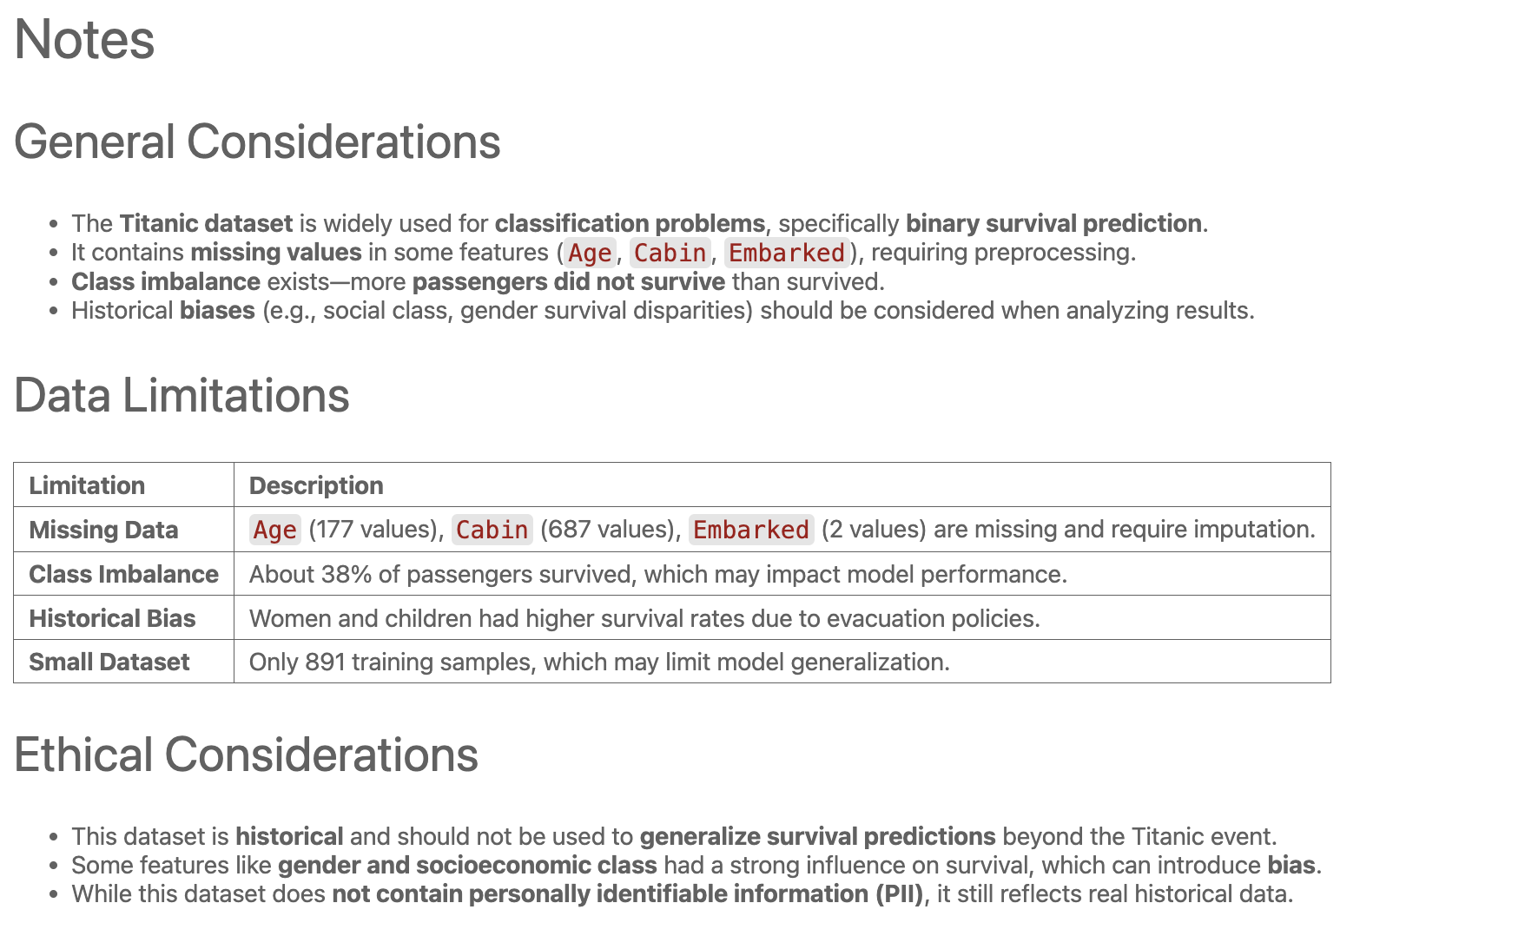
Notes
Captures additional considerations and dataset nuances.
Examples:
Limitations of the data
Special handling requirements
Observations during data exploration

